Slide 1
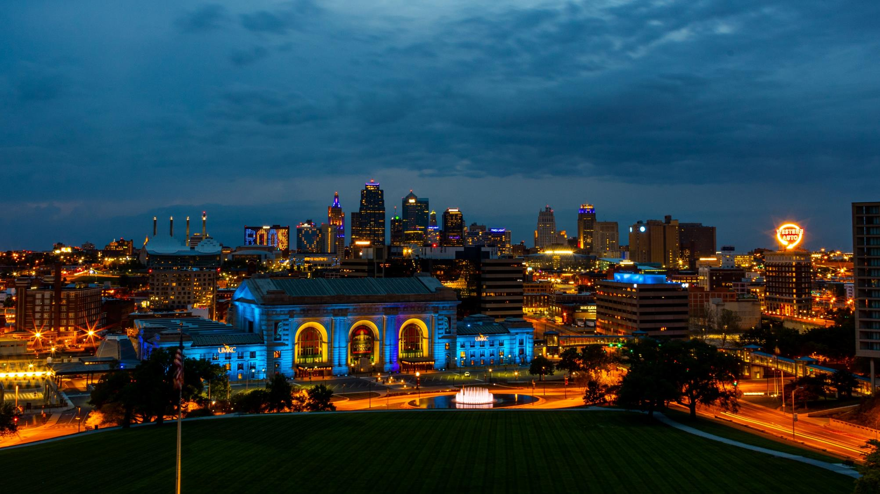
Chancellor’s Highlights
Report
UM System Board of Curators | Sept. 2, 2021

Slide 2
UMKC Forward
Bold investments in excellence

Slide 3
UMKC Forward investments
To invest in strategic initiatives:
Identify resources:
Student Success
Faculty Development
Research Excellence
Career Expansion
Community Engagement
Internal Realignment
Philanthropy
Grants
Increase net tuition revenue
Academic unit realignment

Slide 4
No. 1: Student Success = UMKC Professional Mobility Escalators
TM
Our answer to the question:
How can we engineer the college experience, so students attain their educational and career dreams more quickly and achieve their goal of good paying professions?
First 4 Professional Mobility tracks:
1
Healthcare
2
Education
3
Engineering/Business
4
Law and Justice

Slide 5
UMKC Professional Mobility Escalators
TM
Entry at
Multiple Levels
HS
FTC
Transfer
Core Experiences and Services
Cohorted Summer Bridge
Living-Learning
Advising
Career Services
Academic Support
Mentoring
Professional Access Preparation
Preparation for applying to professional school
Test prep
Personal statement
Interviewing
Signature Applied Experience
Service Learning
Internship
Leadership Badging/ Transcription
Certified Student Leader Program
Co-curricular transcription

Slide 6
No. 2: UMKC Center for Advancing Faculty Excellence (CAFE)
Teaching and Learning Pillar
Research and Creativity Pillar
Service and Engagement Pillar
Career Progression,
Leadership and
Faculty Life Pillar
Instructional Design
Assessment
Scholarship of Teaching and Learning
Grant Mentorship
Proposal Support
Collaboration and Grant Teams
Community Engaged Teaching
Community Engaged Research
Faculty/Community Consultation
New Faculty Orientation
Mid-Career Program
Department Chair Development

Slide 7
No. 3: Blueprint for research excellence
Infrastructure
Invest in grant writers and pre-award/post-award staff
Certified staff; high-impact research clusters withing academic units
Faculty support and development
Add faculty: $5M over the next 3 years.
Start-up funding
Build faculty research skill and capacity
CAFE programming; Matrix mentoring
Free up time through course release/buyout for grant development and submission

Slide 8
No. 4: UMKC-branded badges and certificates through TalentLink
Career Expansion through TalentLink, our UMKC-branded Adult Learner and Corporate Development Program.
Target 1: Adult Learners
Seeking new topic/skill that supports them in building their profession or enhancing their lifestyle; could become degree seeking.
Target 2: Corporate Talent Development
Reskill and upskill talent to meet market demand in an environment that is increasing global.
Leadership and soft skills.
Key UMKC Assets: Leadership, Data Science, Diversity and Inclusion

Slide 9
No. 5: Increase student, faculty engagement with community
Students are our best ambassadors of the great work of UMKC. Increase the number of students doing service learning, internships, and volunteer work in the community; increase opportunities for employment post-graduation.
Leverage our vast community network to expand opportunities for students and make it easier to engage our faculty in finding solutions for community needs.
Facilitate faculty/community collaboration in ways that are mutually beneficial. Support faculty in community engaged scholarship and service.

Slide 11
UMKC School of Medicine
Furthering our mission of excellence and reaching the underserved

Slide 12
Celebrating 50 years of excellence
2022 Rankings
17th in Most Graduates Practicing in Medically Underserved Areas
64th in Primary care
78th in Most Diverse Medical Schools
83th in country in research
Notes:
122 med schools participated in 2020 ranking out of 189 in the US

Slide 13
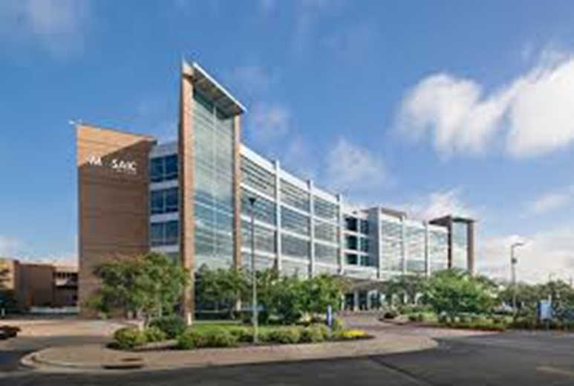
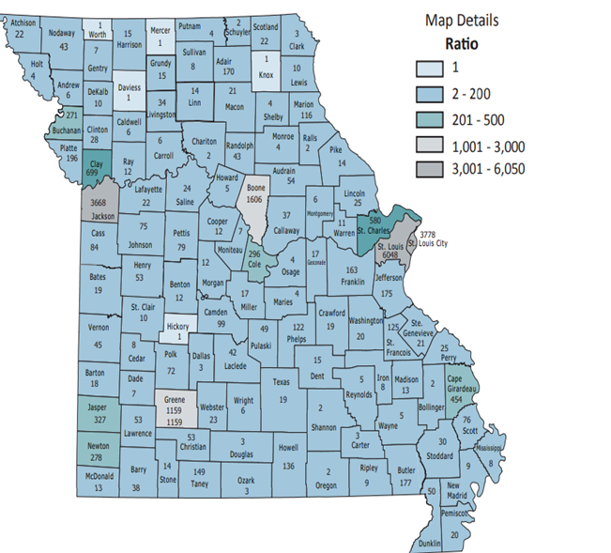
St. Joseph campus, Semester 2
Solving for significant provider shortages
Medically underserved, low-income, including tribal peoples and people with limited English proficiency
HRSA grant: $12 million dollars over 4 years to create rural healthcare program
Partners with Mosaic Life Care, a Mayo Clinic network of 350 tertiary care facilities, with more than 40 rural clinics
Provider gaps

Slide 14
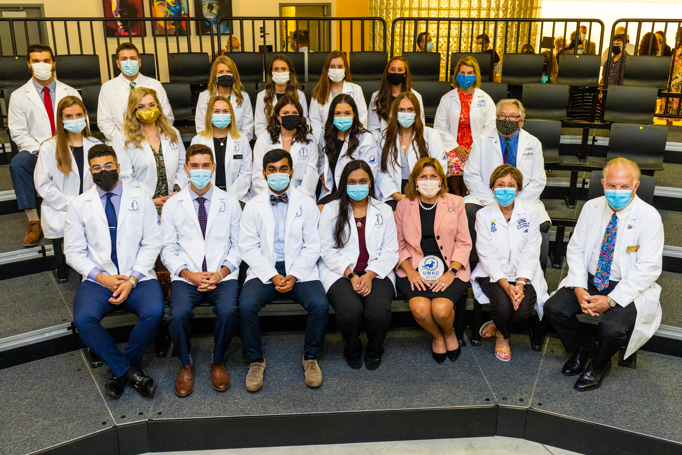
St. Joseph campus model
Top-notch facilities and innovative programs
St. Joe students interact with KC campus, complete the same curriculum
Emphasis on rural healthcare experiences and reducing health inequities
Clinic core inpatient rotations at Mosaic
GME programs at St. Joseph will include: Family medicine, internal medicine, emergency medicine, psychiatry

Slide 15
First Gen Roos
Getting results in retaining students and propelling them toward graduation

Slide 16
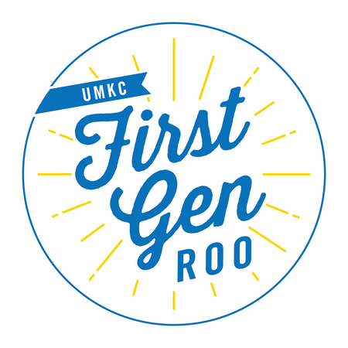
New First Gen Roo Scholars Program
UMKC designed a program for incoming, full-time freshmen students whose parents or guardians did not receive a bachelor's degree.

Slide 17
What does the program look like?
Students come a week before fall classes begin to get familiar with campus, resources, community-building and academic experiences
Throughout the year, they get interactive programming on topics such as navigating technology, college lingo and financial literacy specially designed by fellow first-gen students and UMKC resource offices
They are paired with a first-generation peer mentor
They develop personalized plans and goals for first semester and beyond

Slide 18
Outcomes of First Gen Roos
Launched in 2019, First Gen Roos Scholars recruits 40 students per semester, with plans to expand further based on early successes.
The program goal is to increase retention, persistence and successful degree completion.
Early results show First Gen Roos Scholars earn higher GPAs and are retained at higher rates than all FTC AND other First Gen students.
Notes:
The 40 summer and fall 2020 program participants (a high financial need group) had higher GPAs (FS20) and better retention rates (FS20 to SP21) than all UMKC FTC and all first gen FTC

Slide 19
Research Excellence
Leading the way in innovation

Slide 20
Holly Hagle, Ph.D Assistant Research Professor
Co-director of the Addiction Technology Transfer Center Network Office at the School of Nursing and Health Studies.
Conducts opioid addiction research funded by the Substance Abuse and Mental Health Services Administration.
Research awards (5-year total): $43.7M

Slide 21
Tony Caruso, Ph.D. Curator’s Distinguished Professor
Founding director of the Missouri Institute for Defense and Energy
Groundbreaking research on drones, microwave technology, AI for defense against terrorism (sponsored by Office of Naval Research)
Research awards (5-year total): $36M

Slide 22
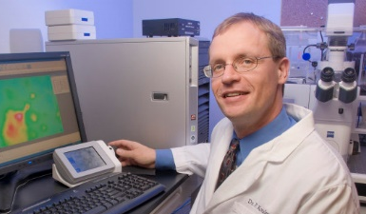
Peter Koulen, Ph.D., FARVO Professor and Felix & Carmen Sabates Missouri Endowed Chair in Vision Research
Groundbreaking NIH- and DOD-funded research on glaucoma, macular degeneration and TBI
Research awards (5-year total): $16.5M

Slide 23
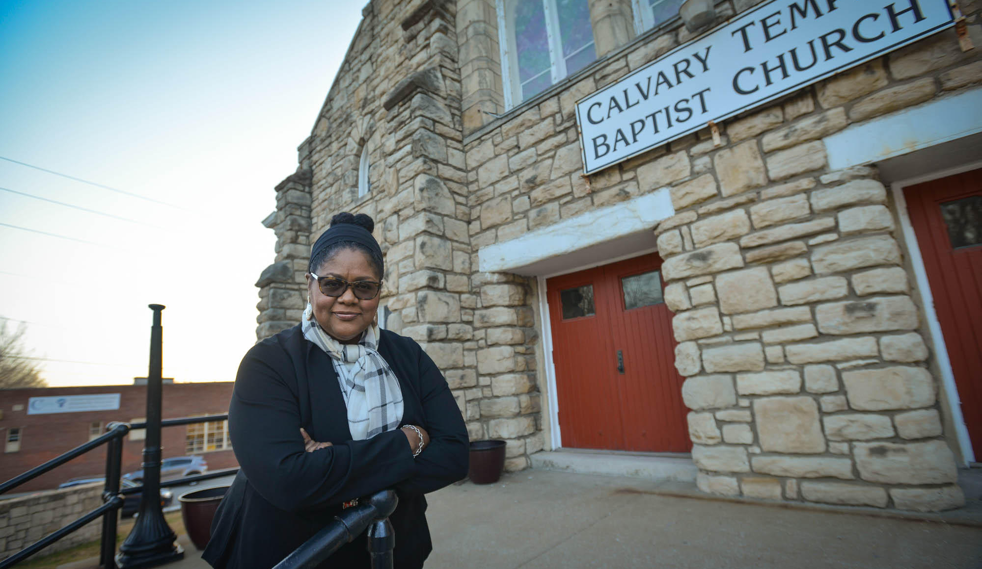
Jannette Berkley-Patton, Ph.D. Professor
Director of UMKC’s Health Equity Institute at the UMKC School of Medicine
Community-based intervention trials for improving health behavior in large community-based studies, e.g., COVID-19, diabetes, AIDS.
Research awards (5-year total): $9.5M

Slide 24
Alexis Petri, Ed.D. Research Associate Professor
STEM education focus
Recently selected to serve as backbone for $10M National STEM Education Initiative for students with disabilities funded by the National Science Foundation
Research awards (5-year total): $5.5M

Slide 25
New campus additions
Furthering our strategic vision

Slide 26
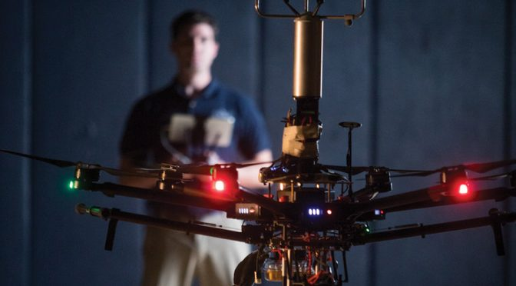
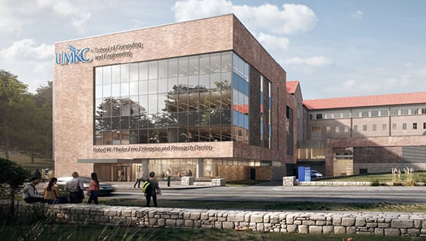
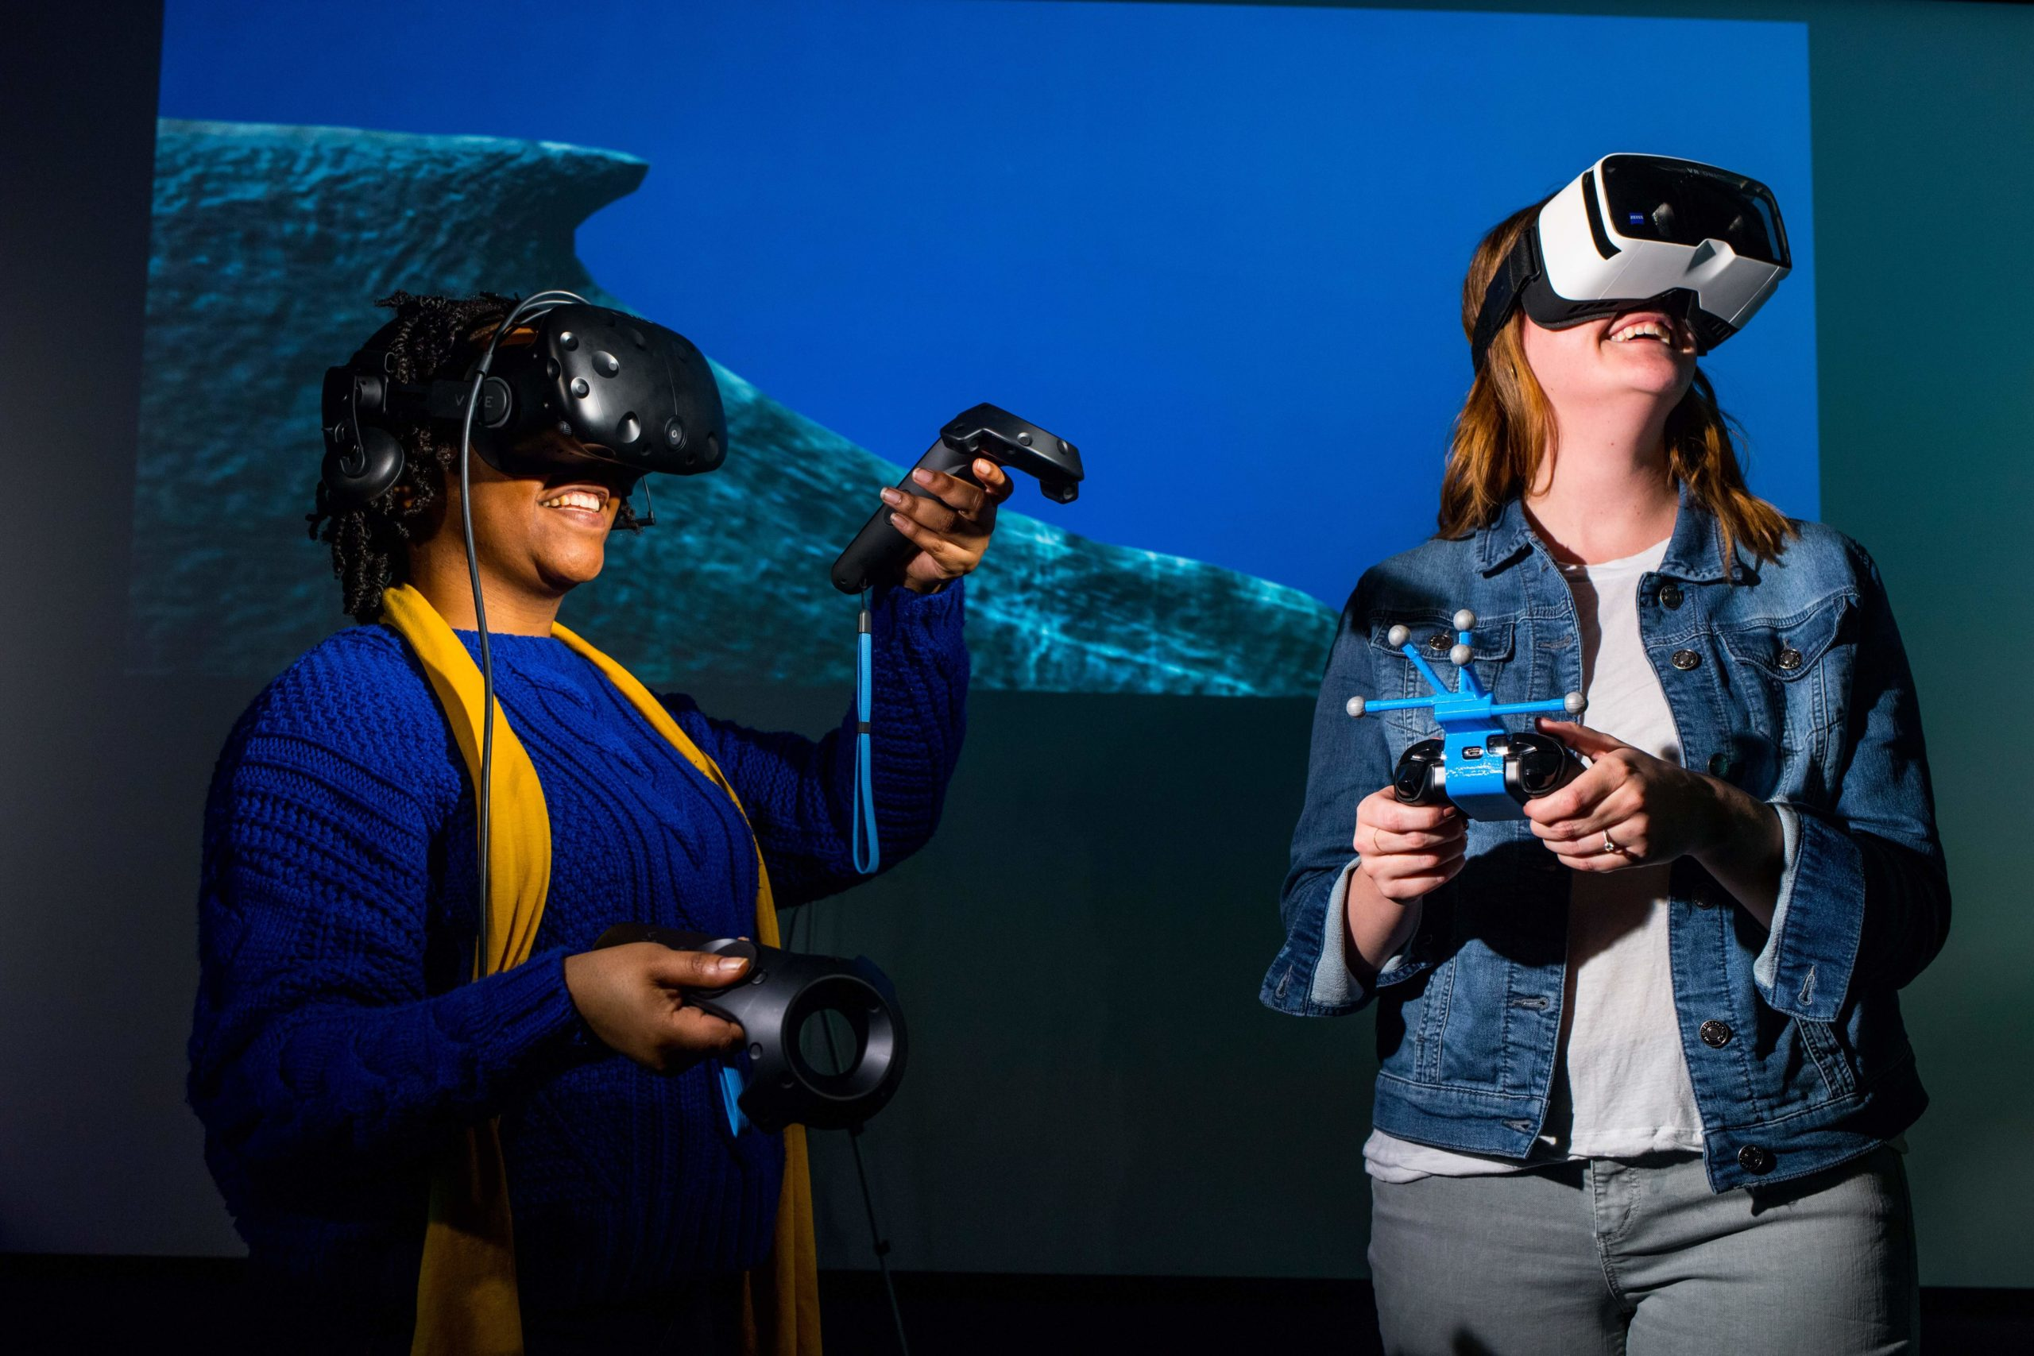
Grand opening of the Plaster Center
Oct. 1 Grand Opening of the Robert W. Plaster Center Free Enterprise and Research Center
$3 million worth of new virtual reality and augmented reality equipment
A clean room and scanning electron microscope
Research-grade 3-D printing
equipment
A high-bay structural lab and
fabrication shop

Slide 27
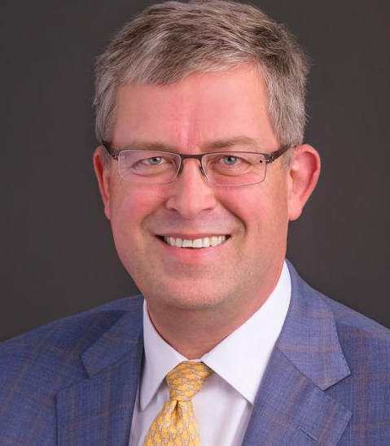
Data Sciences Analytics and Innovation Center
dSAIC is a true collaboration between UMKC and MU and will:
Provide high-performance computing for UM System as well as industry, government, and nonprofits
Foster new innovations in precision health, biomedical informatics, life sciences, cybersecurity, digital humanities and more
Provide education and training programs for students to pursue a career in data science and analytics
dSAIC’s physical home base is in the Plaster Research Center
Dr. Russ Waitman,
Joint appointment
at MU and UMKC

Slide 28
Challenges facing UMKC
Aging capital infrastructure
25% of facilities due for replacement, another 30% nearing replacement age
Enrollment management
Declining faculty numbers
Notes:
Buildings with a FCNI greater than .50 can be considered for replacement.
25% of UMKC facilities have an FCNI greater than .50

Slide 29
New Roo traditions
Creating community and sense of belonging with a unique UMKC twist

Slide 30
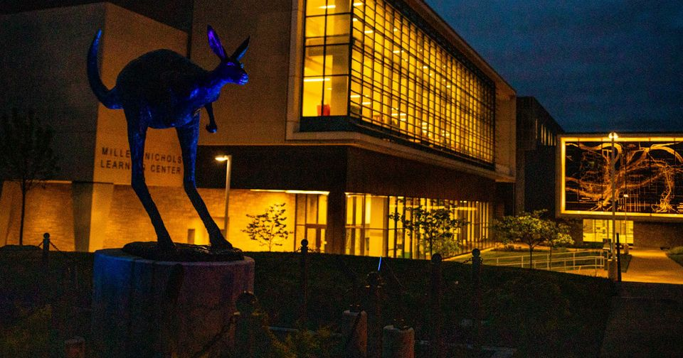

Slide 32
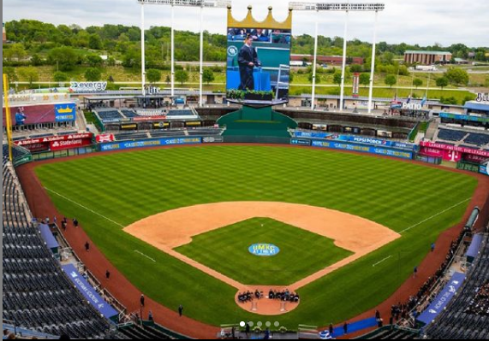
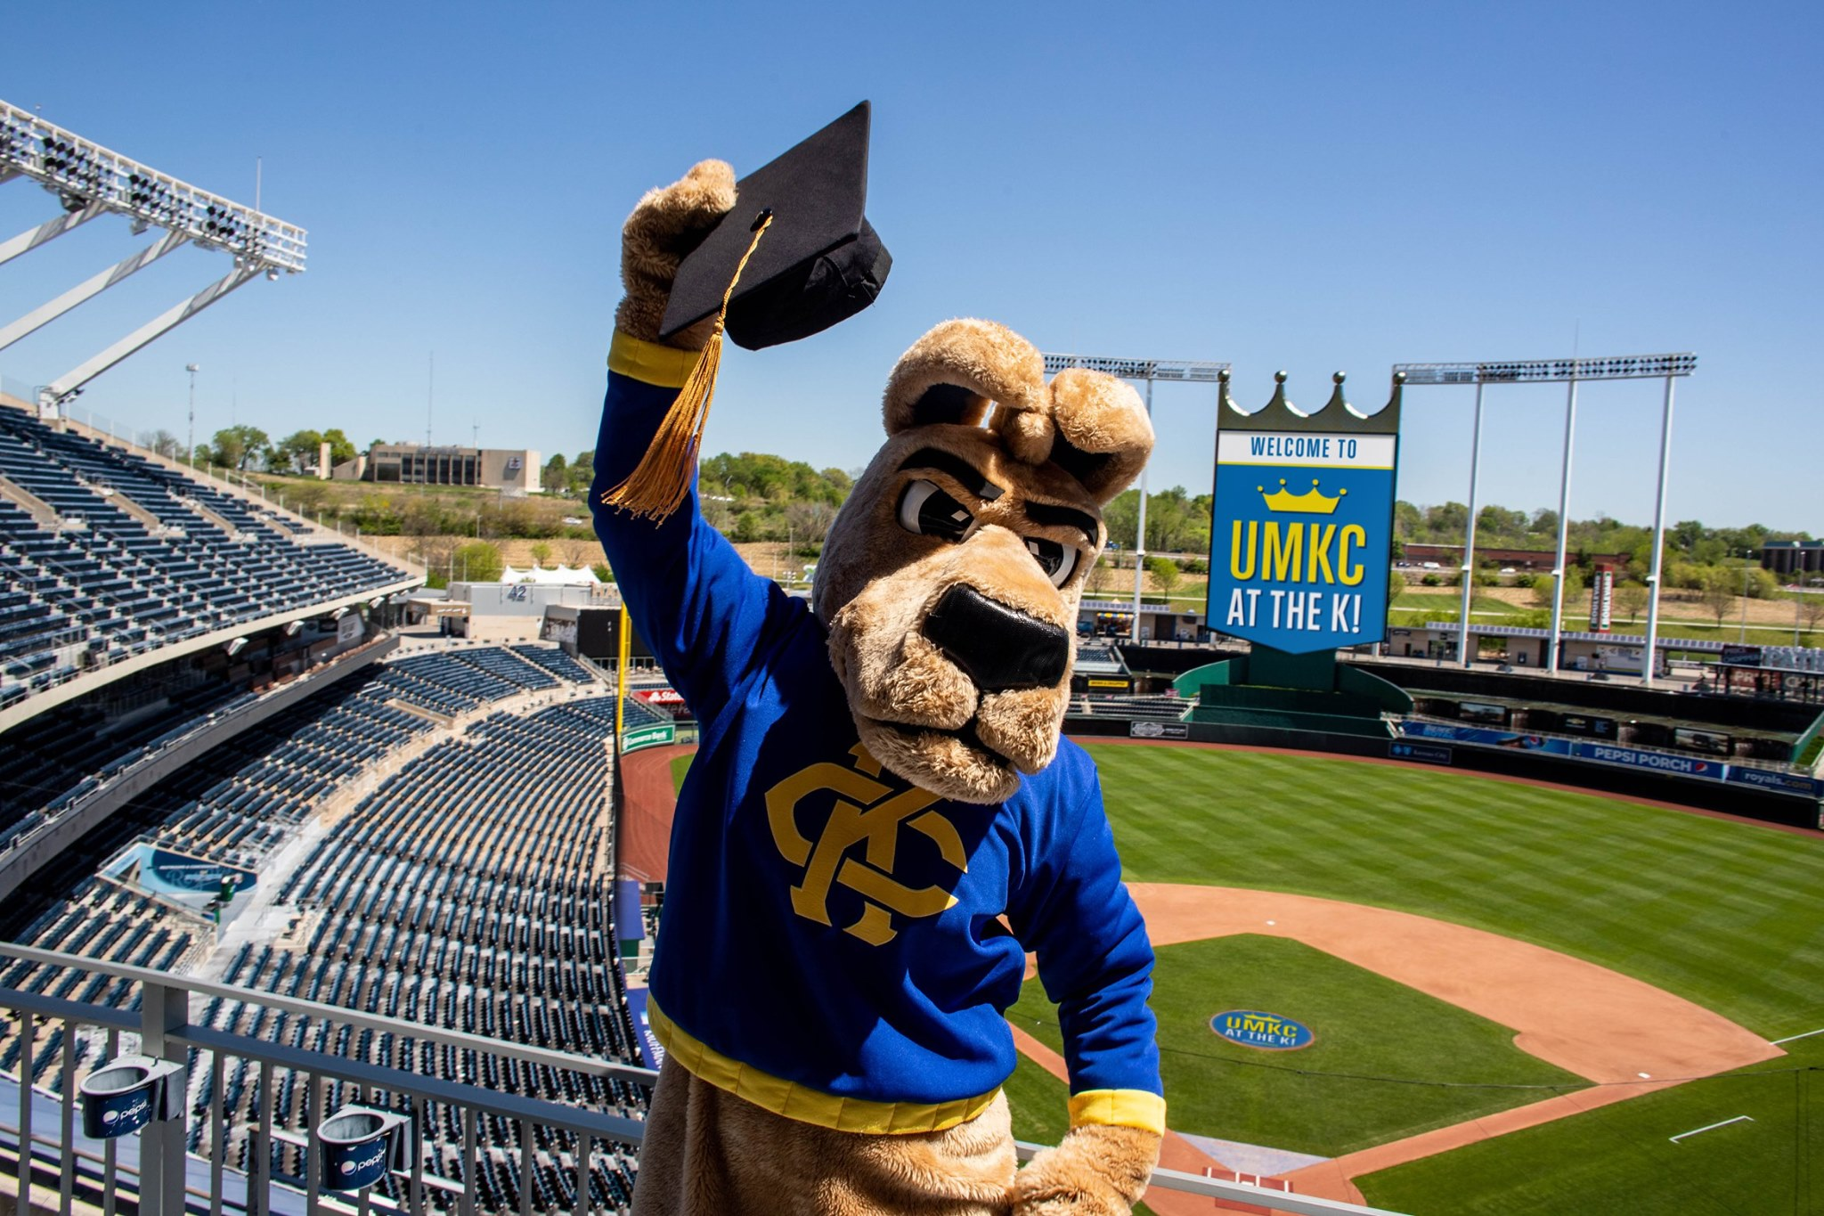

Slide 33
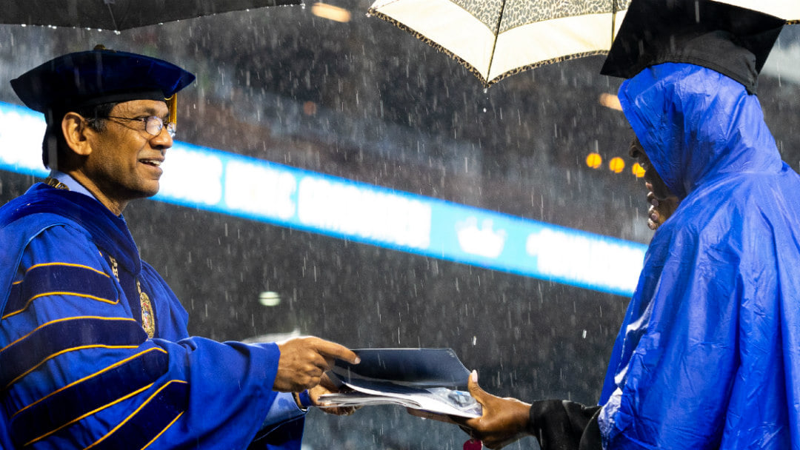
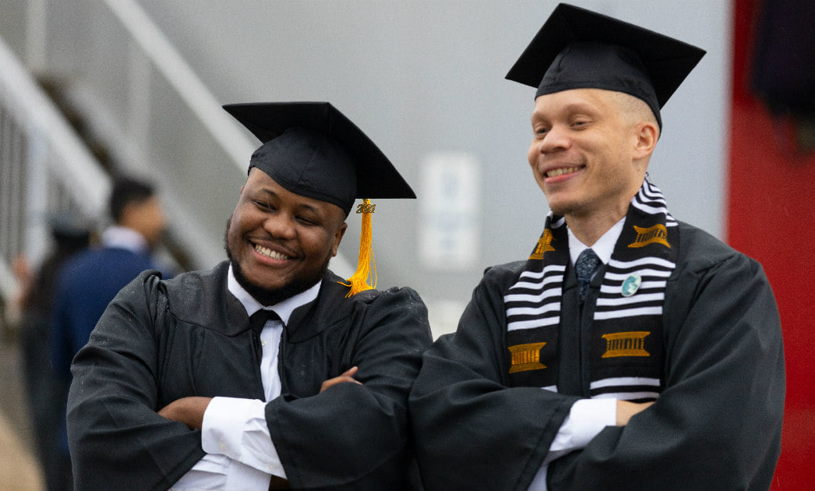
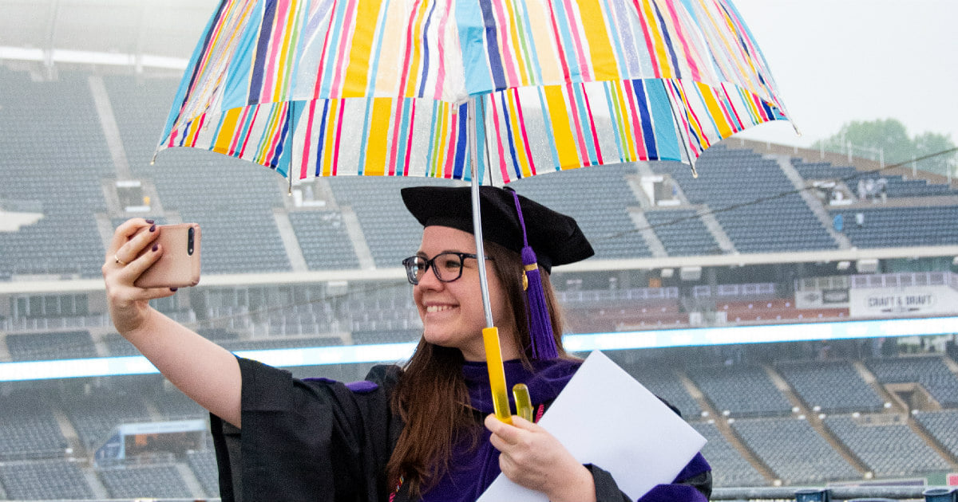
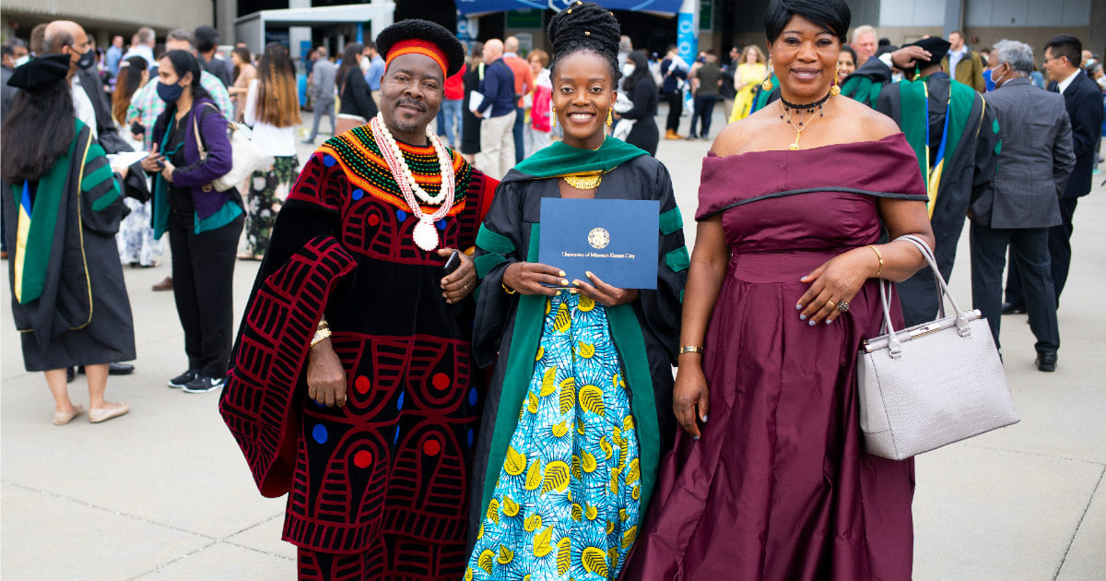
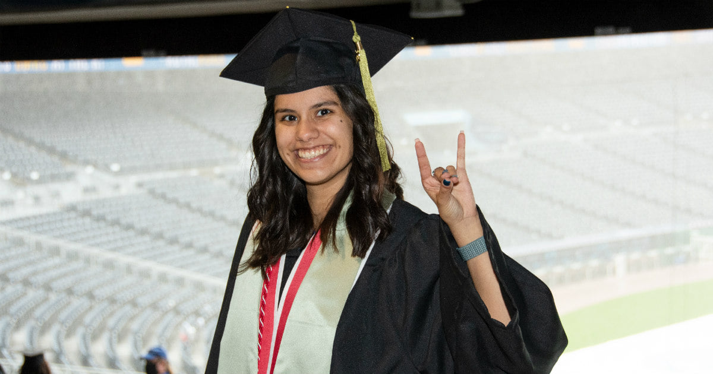

Slide 34
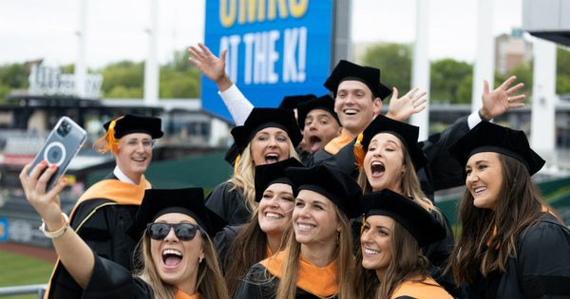

Slide 35
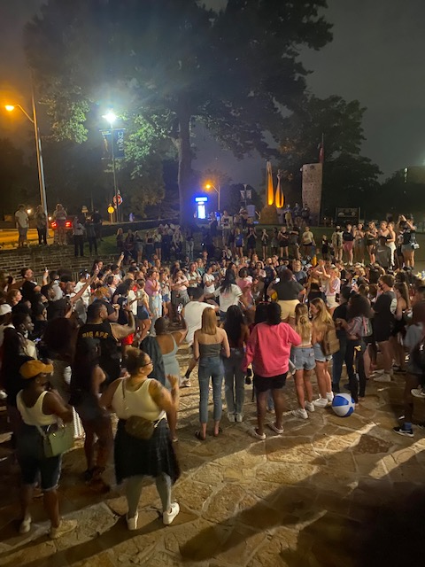
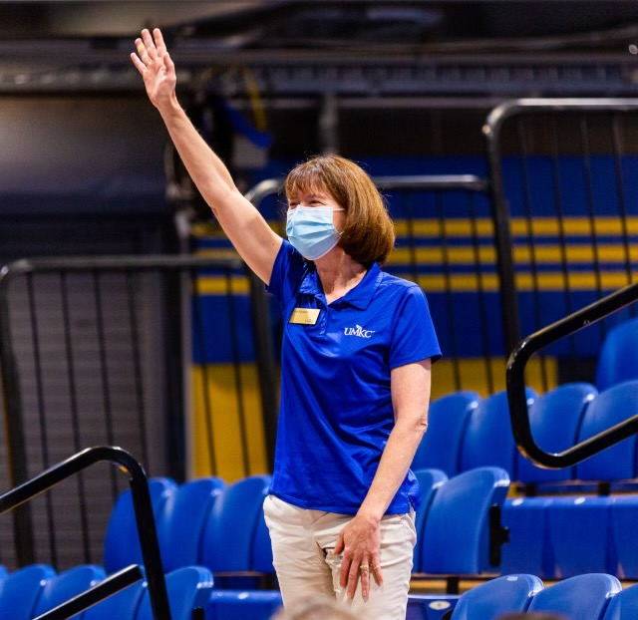
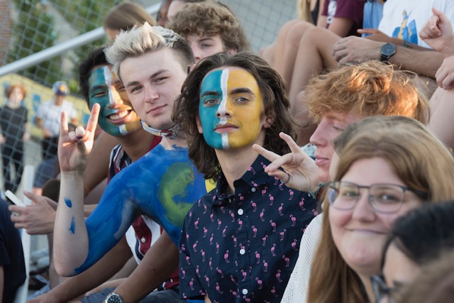
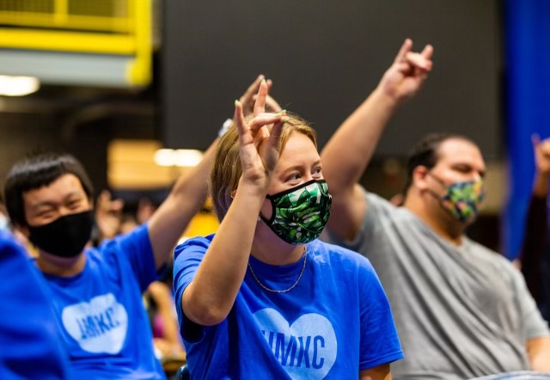
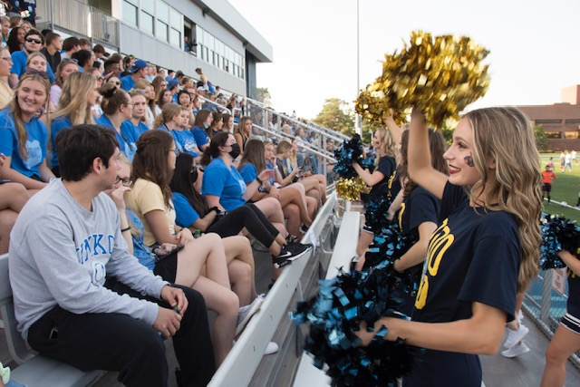
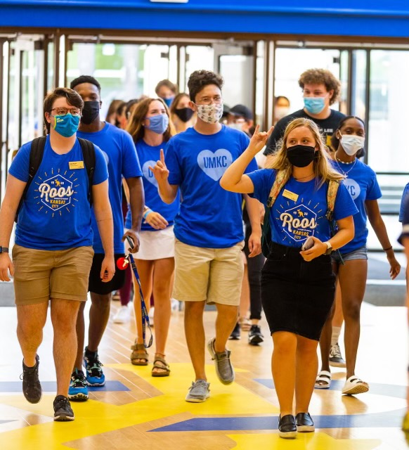
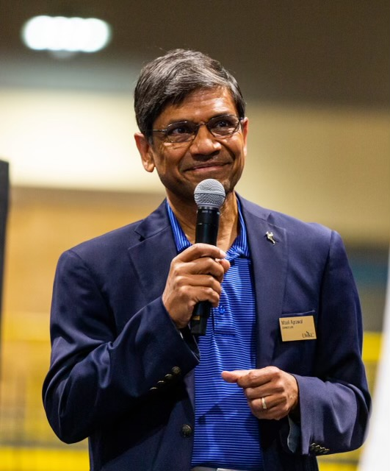
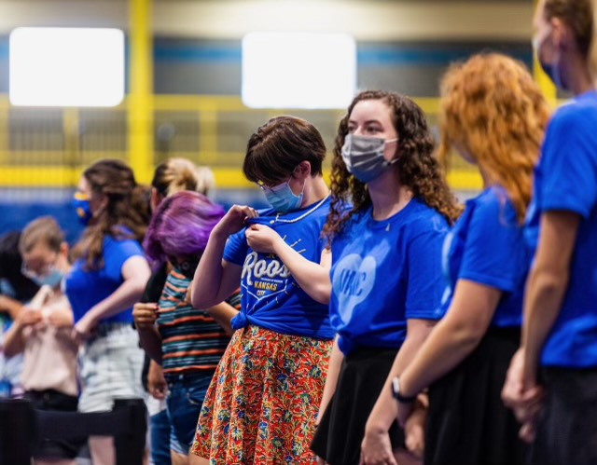
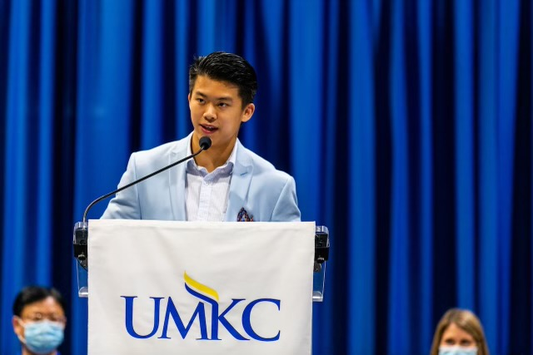

Slide 36
The End

